Slide 1
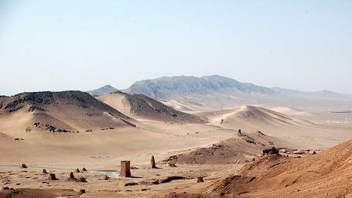
Middle East Research During Time of Crisis Charles Kurzman University of North Carolina, Chapel Hill http://kurzman.unc.edu May 18, 2020

Slide 3
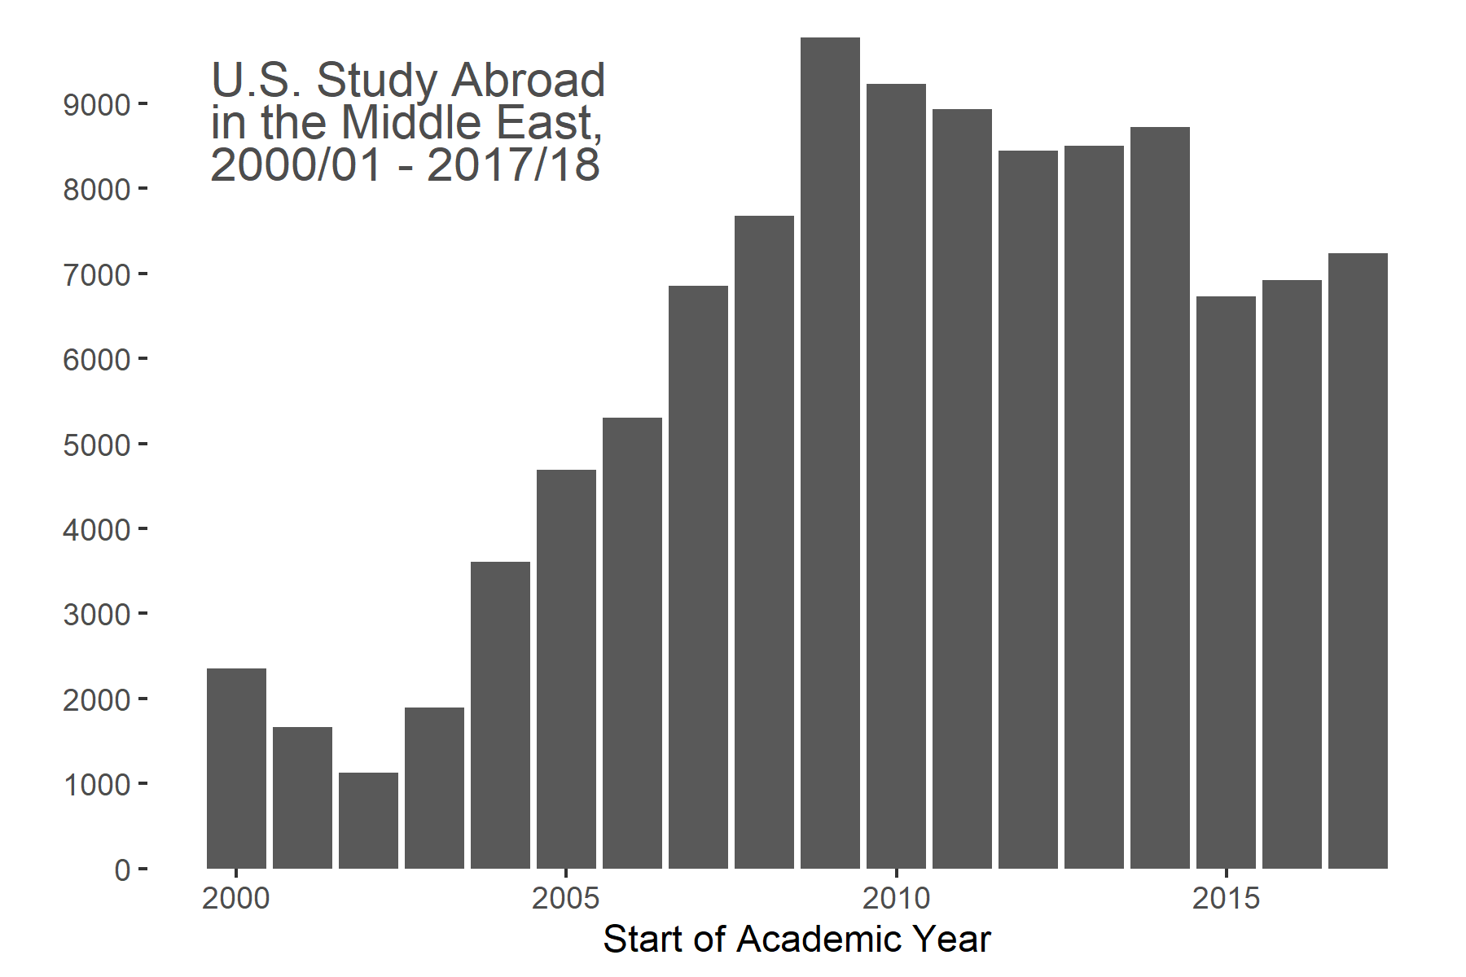

Slide 4
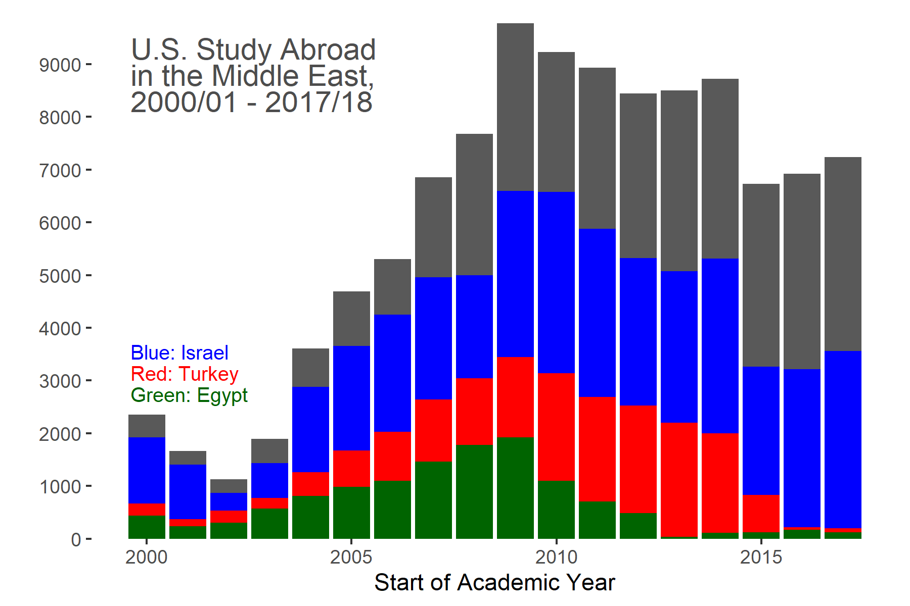

Slide 5
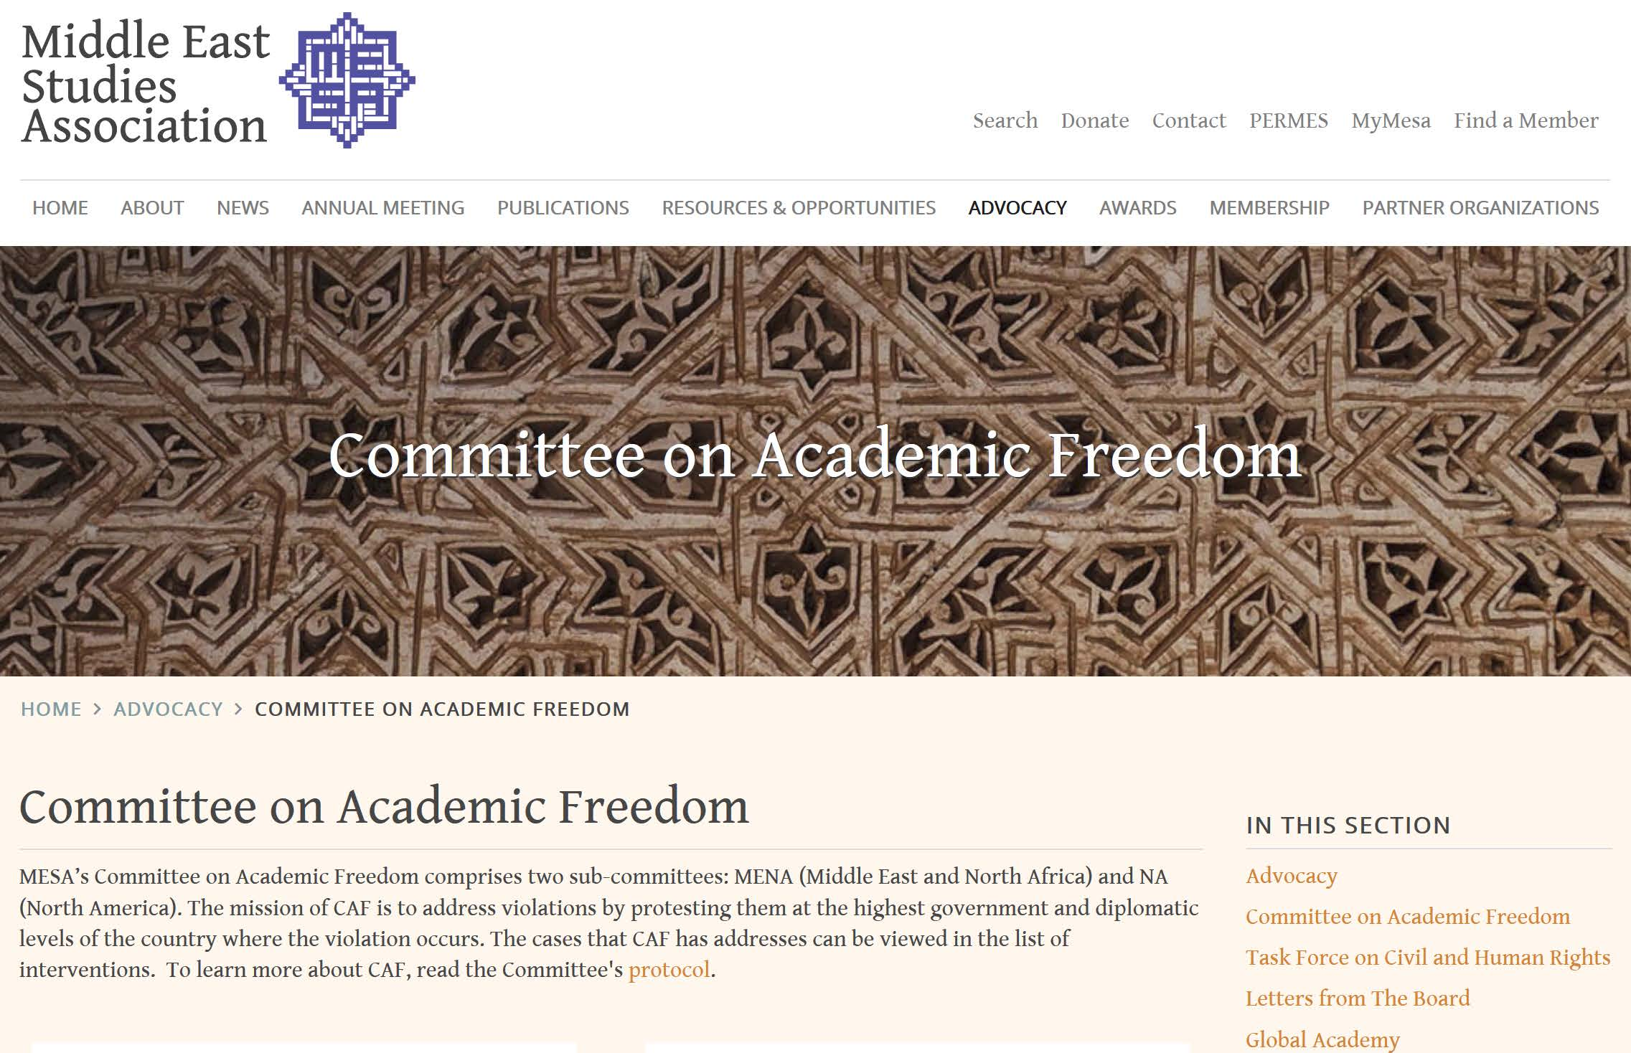

Slide 6
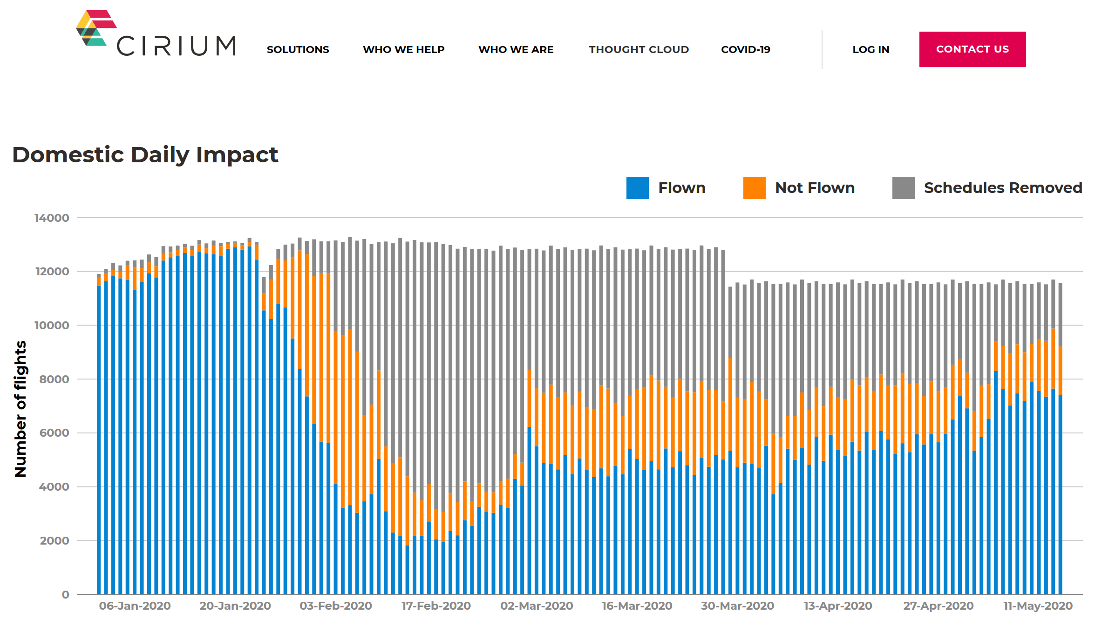

Slide 7
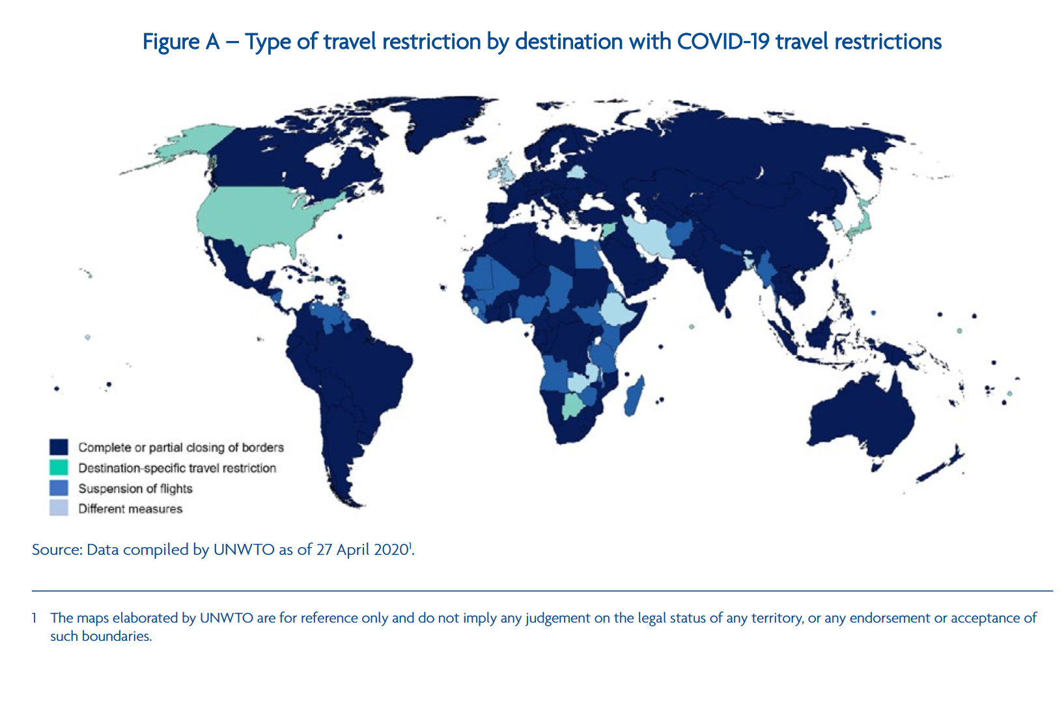

Slide 8
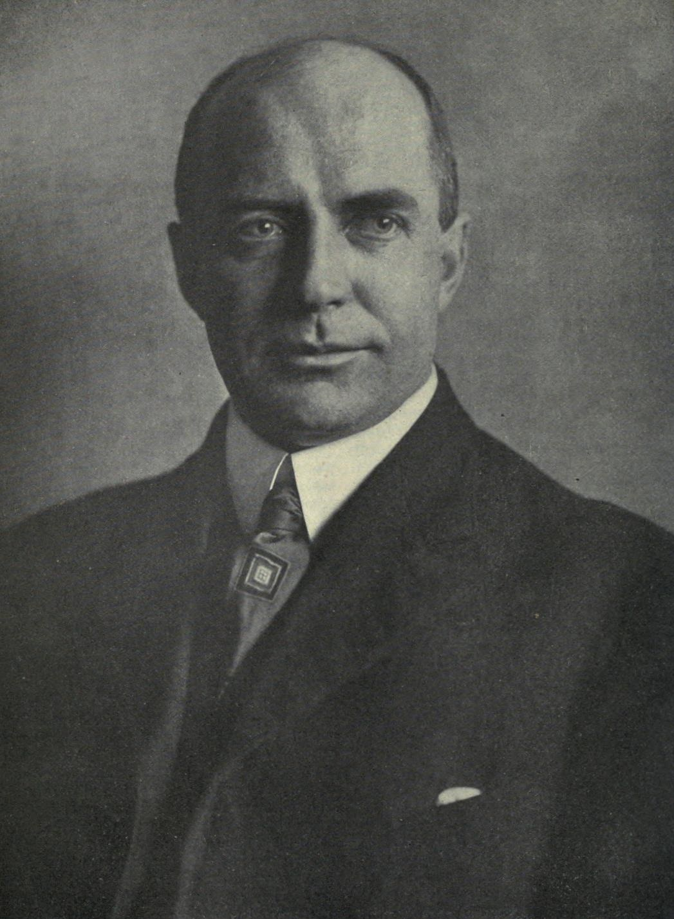
Ali Kadivar, Boston College

Slide 9
http://mideast.unc.edu/library-resources

Slide 10
http://archive.org

Slide 11
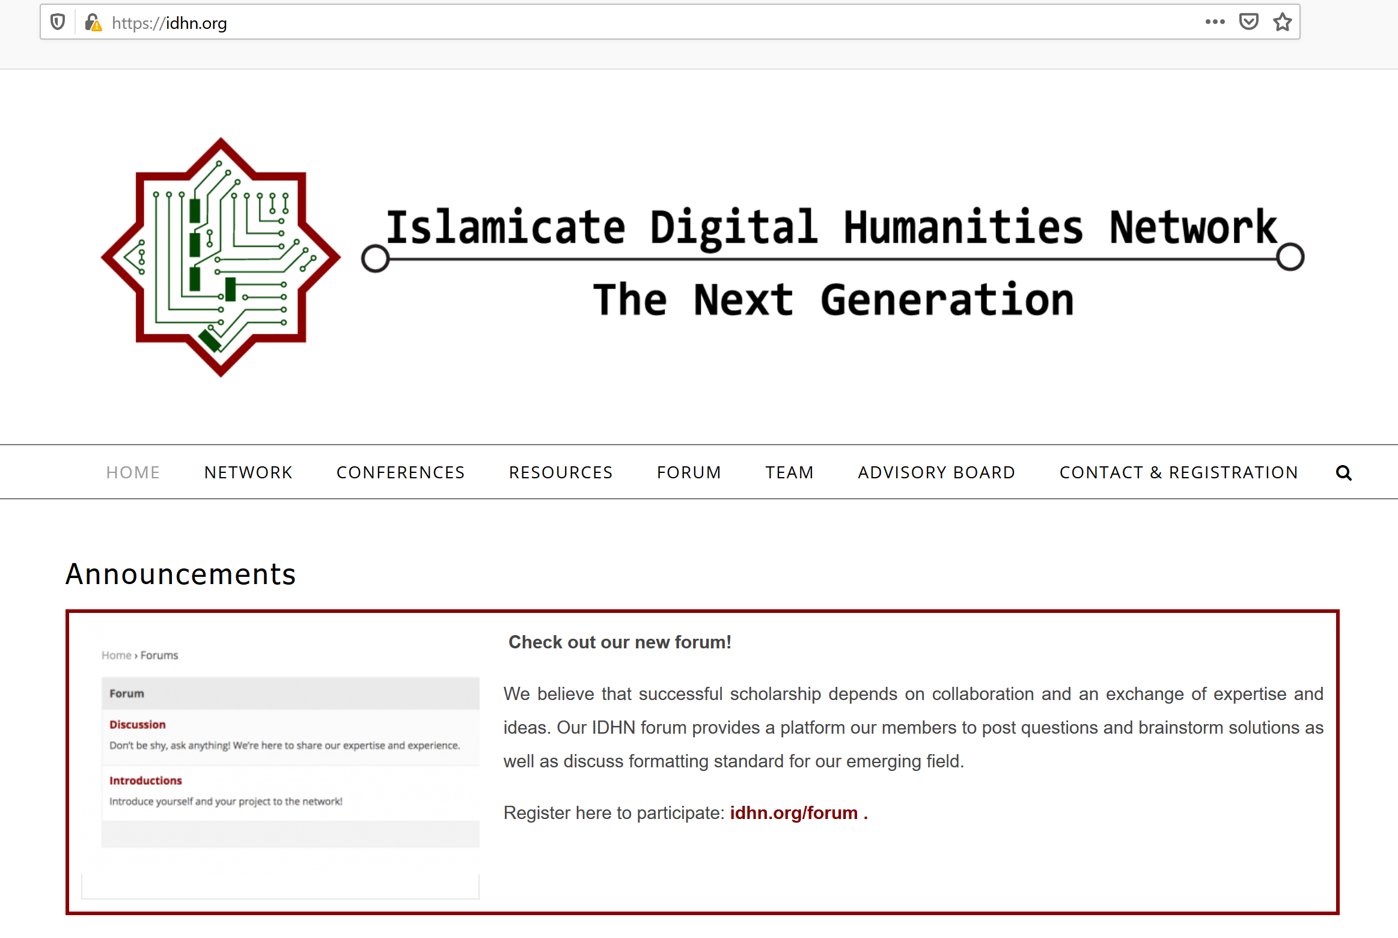
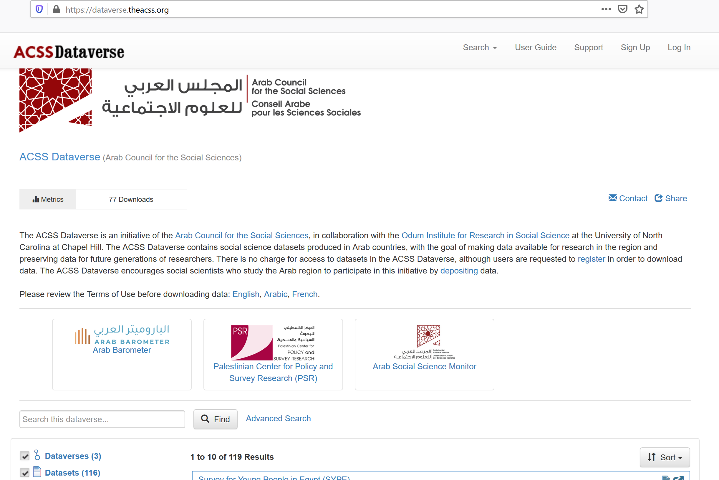
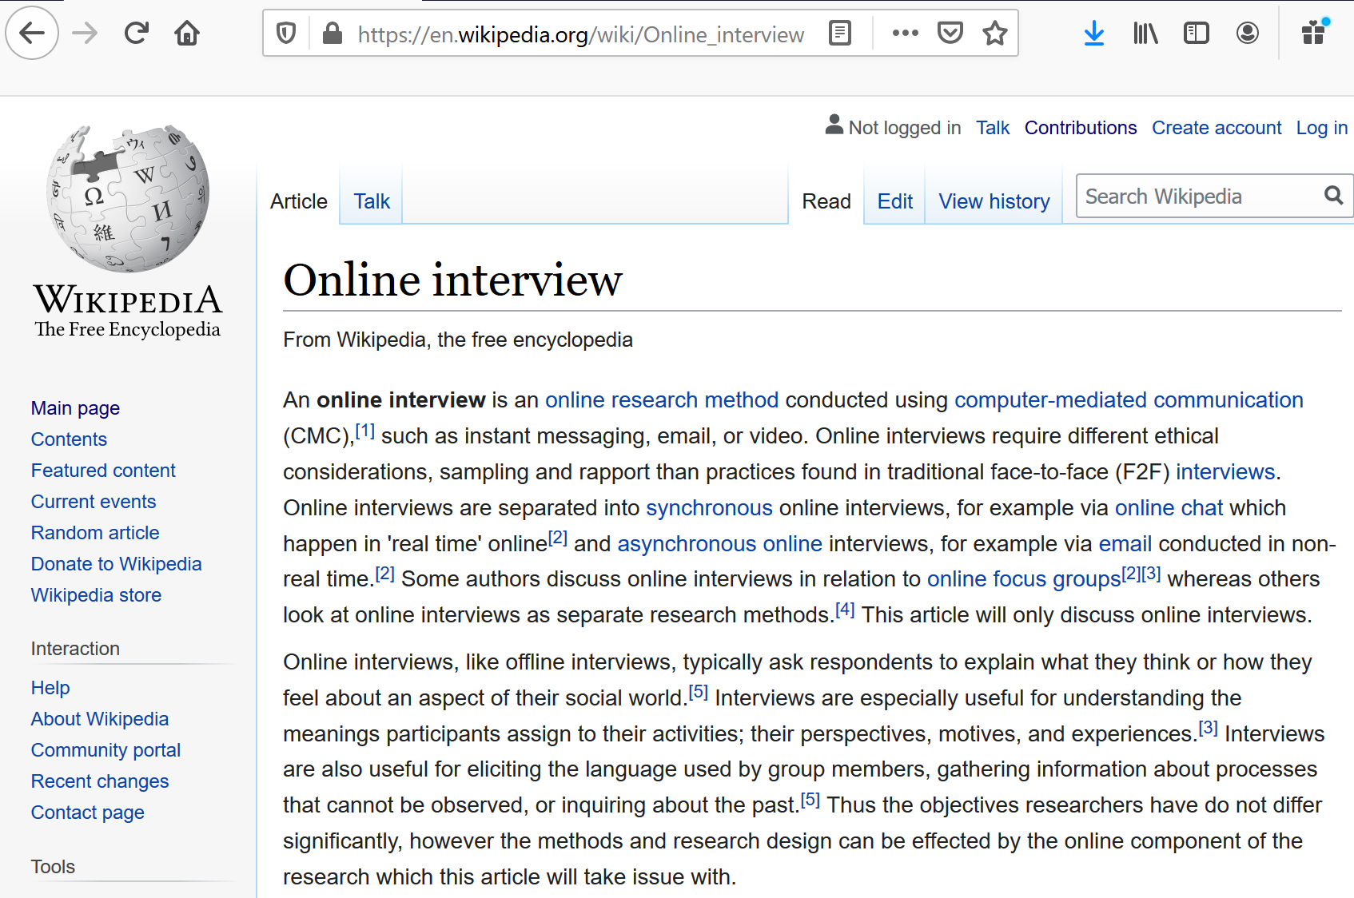
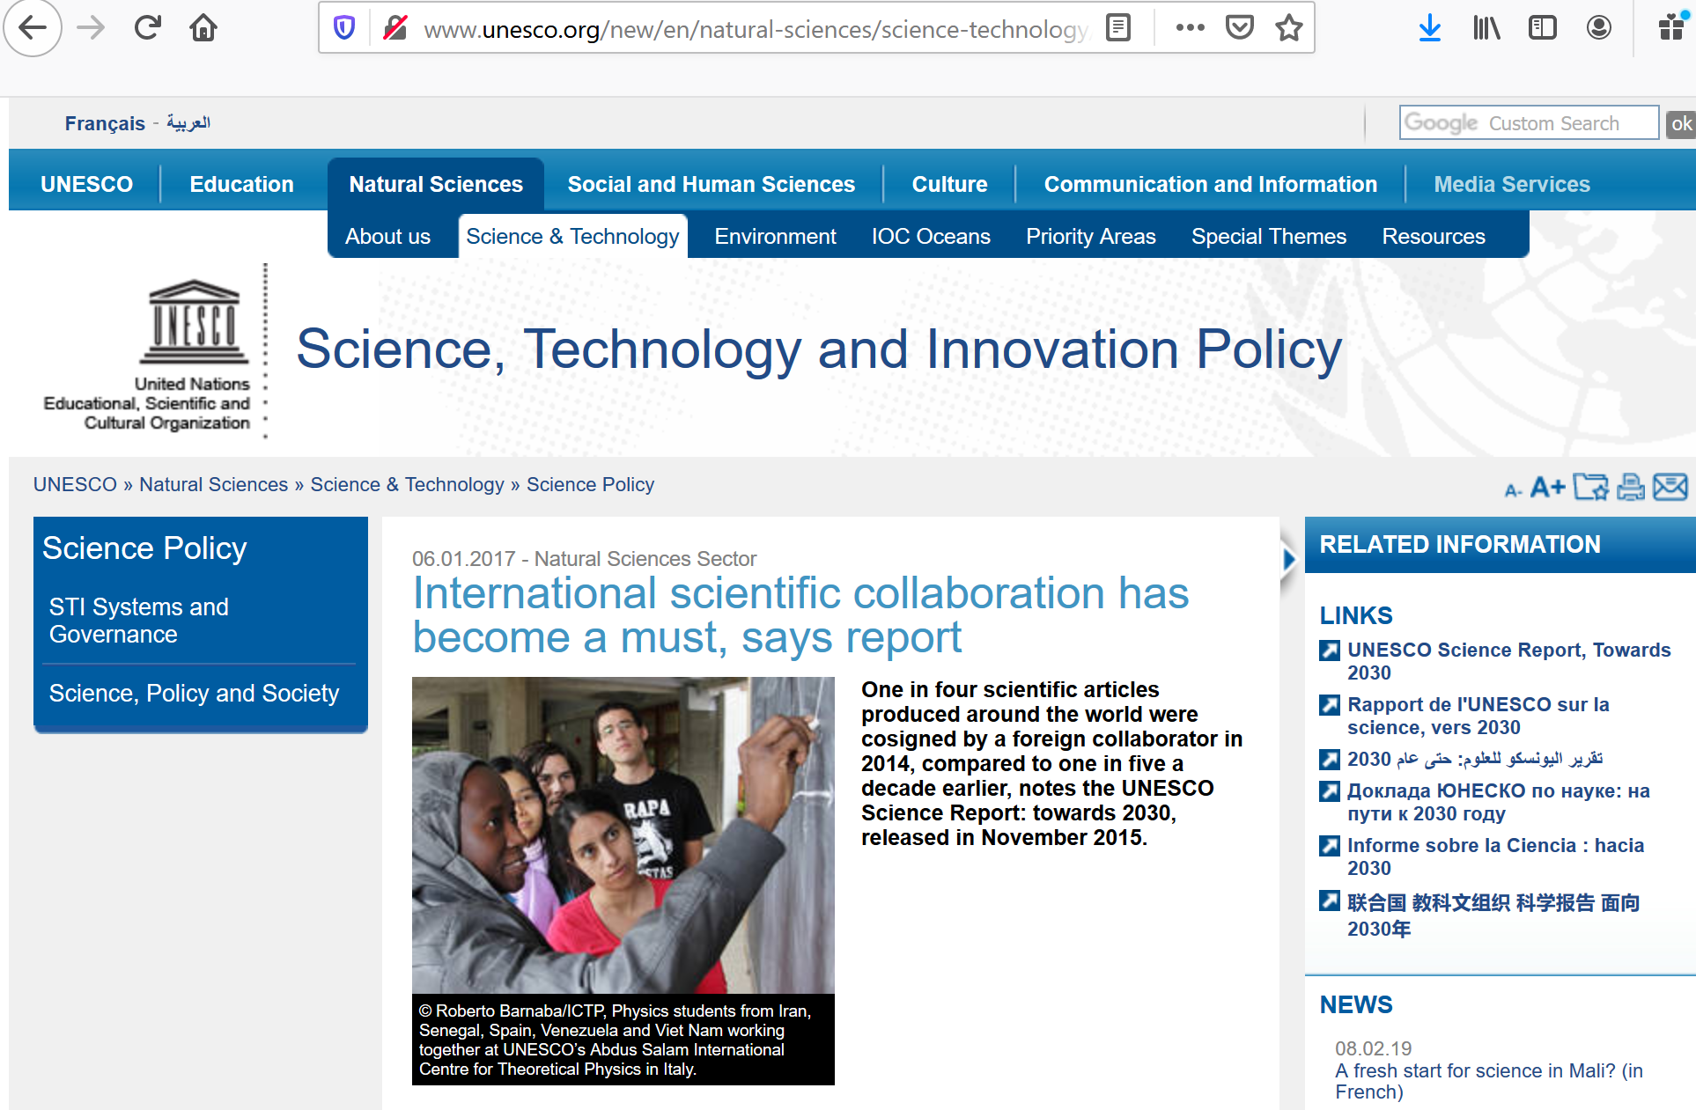

Slide 12
Middle East Research During Time of Crisis Charles Kurzman University of North Carolina, Chapel Hill http://kurzman.unc.edu May 18, 2020

